Slide 1
Nature of Software Design
What is design?
The role of design activity
Design as a problem solving activity
Design as a wicked problem

Slide 2
What is design
Design is a set of activities that need to be performed by the designer in deriving and specifying a solution to a problem
Design is a set of activities that need to be performed by the designer to produce a workable solution
There is an order or sequence to these actions
There may be more than one possible solution for a given problem
The fitness of the solution is measured by the correctness or appropriateness of that solution

Slide 3
A model of the design process
Clarify
Nature of
Requirements
Req
Specification
External
Requirements
Build a black box
Model of
problem
Functional
specification
Functional
specification
List of
mismatches
Postullate
White box
Design
solution
Validate
Solution
By
prototype
White box
model
Implementation
Of design plan
Using a s/w

Slide 4
The design process consists mainly 4 activities
  Postulate a solution
  Build a model of the solution
  Evaluate the model against original requirements
  Elaborate the model to produce a detailed specification of the solution
The nature of the design process
  The design process will not be implemented in a single precise sequence
  The design process is iterative in nature
  The design process contains the extensive backtracking

Slide 5
Moving House Example
The following parameters will be considered while moving to a new house
  Plan
  Initial model
  Strategies
  Constraints
  Modularity
  Quality
  Reuse
Even the same set of parameters will be considered for designing a solution to a problem

Slide 6
The Role of Design Activity
The main task of design activity is to produce the plans necessary for s/w production to proceed
The form and extent of the plans will be determined by the design practices, means of implementation and size of the system being developed
The plans will be concerned with describing
  Structure of the system including sub programs
  Data objects to be used in the system
  The algorithms to be used
  Packaging of the system
  Interactions between the components
  Designing process
  Viewpoints (E-R,DFD)
The plan should even specify how the final product is to be assembled by making use of components

Slide 7
Channels of Communication of Designer
Designer derives “plans” by making use of 3 resources
Requirements
specification
Designer
Plans for
Realization of the
design
Constraints
Domain knowledge

Slide 8
Design as a Problem Solving Process
The purpose of the design is simply to produce a solution to a problem
The final solution should fulfill the ultimate requirement i.e. it should work and do the required job apart from the other factors like size, speed, ease of adoption, look &feel
Designer gets help from number of tools like design methods ,design patterns, representations while designing the solution
Even abstraction plays very important role while developing the solutions for large and complex systems

Slide 9
Design as a Wicked Problem
A wicked problem can be considered to be symptom of another problem
  Every wicked problem is essentially unique
  Wicked problems do not have an enumerable set of potential solutions
  Wicked problem have no stopping rule
  Solutions to wicked problems are not true or false, but good or bad
Even the same strategy will be applicable to the s/w design

Slide 10
The Software Design Process
Designer Formulates and Develops an Abstract Design Model Representative of the Solution
Why is This Process Not Understood as Well as Other Forms of Design?
  The Complexity of Software
  The Problem of Conformity
  The (Apparent) Ease of Changeability
  The Invisibility of Software

Slide 11
Phases of software design process
Requirements Specification
Architectural design decisions
Logical design details
Detailed design decisions
Physical design details

Slide 12
Transferring Design Knowledge
Codifying and exchanging experiences about the processes involved in design and resulting design features that have proved effectively gaining design knowledge.
The characteristics of an exceptional designer:
1)Familiarity with the application domain
2)Skill in communicating technical vision to other project members.
3)Identification with project performance
Familiarity with application domain
Skill in communicating
Technical vision to others
Identification with
Project performance

Slide 13
Other Parameters In Gaining Design Knowledge
Design methods
Design patterns
The process part
The representation part
Heuristics
Verification and validation operations
Quality measures
Identification of certain constraints

Slide 14
Design Constraints
Designing Software is Rarely an Unconstrained Process
Examples of Constraints
  Programming Language to be Used
  Execution Environment or Operating System
  Performance Expectations
  User Interface Needs

Slide 15
Recording design decisions
The need to record the design decisions from the viewpoint of design and maintenance tasks
The design and maintenance can be extended and modified by making use of design decisions
Quality control is the main intension to record the design decisions
Benefits to the new members of design and maintenance teams
Generally design decisions are represented through the diagrams or other notation

Slide 16
Designing with others
We need to consider some parameters while designing a solution to problem
  Social
  Organizational
  Economical
  Political

Slide 17
Role of Software Design
Question…
  “What exactly is the purpose of Design?
Answer…
  “To produce a workable (implementable) solution to a given problem.”
Fitness for Purpose
  The Key Measure of the Appropriateness of Any Solution

Slide 18
Design – Problem-solving Approach
Is There Only One Solution to a Problem?
  Rarely…Almost Never
  Moving House Example
Is There a Systematic Approach to Design?
  No, a Designer Must Create Each System
    Identify the Properties Required
      Stake Holders (Customer, Users, etc.)
    Devise a Structure That Possesses the Properties
What Can a Designer Use in This Effort?

Slide 19
Design – Main Characteristics
Main Characteristics Found in Almost All Design Problems
  No Single “Right” Solution
  Many Factors and Constraints to be Balanced in Choosing a Solution
  No One Measure of “Quality”
  No Particular Process That Can Ensure That We Can Even Identify an Acceptable Solution

Slide 20
Software Design Process
Designer Formulates and Develops an Abstract Design Model Representative of the Solution
Why is This Process Not Understood as Well as Other Forms of Design?
  The Complexity of Software
  The Problem of Conformity
  The (Apparent) Ease of Changeability
  The Invisibility of Software

Slide 21
Gaps in Domain Knowledge
Software Design Method
  Used When a Designer Lacks Experience or is Unfamiliar With the Problem to be Solved
  Limited to Forms of Design Practice That Can be Prescribed in a Procedural Manner
These Methods Provide…
  A Representation Part
  A Process Part
  A Set of Heuristics

Slide 22
Design Constraints
Designing Software is Rarely an Unconstrained Process
Examples of Constraints
  Programming Language to be Used
  Execution Environment or Operating System
  Performance Expectations
  User Interface Needs

Slide 23
Design in the Software Development Cycle
Constraints Affect the Design Process and the Form of the Product
Set of User Needs to be Met
  Fitness of Purpose
  Requirements Elicitation and Analysis
    Leads to Identifying Inconsistencies Between the Requirements and the Solution
Designer Must “Think Ahead”
  Short Term Use, Long Maintenance Effort, Stability of the Solution Space, etc.

Slide 24
Design Qualities
Fitness of Purpose Doesn’t Provide an Absolute Measure of Quality
  Correct and Within Constraints May Not be Enough to Achieve Fitness of Purpose
Quality Factor “ilities”
  Reliability
  Efficiency
  Maintainability
  Usability

Slide 25
Assessing Design Quality
A Systematic Form of Measurement is Difficult to Achieve
Favorable Assessment Techniques
  Design Walk-through Meetings
  Reviews
  Refactoring (XP)
How Often?

Slide 26
Representing abstract ideas
Abstraction plays an important role in the design process
The designer needs ways to represent abstract ideas about the problem models, design objects and about the various relationships that will exist between these
A representation is used for mainly 3 purposes
  To capture the designer’s ideas for a solution
  Explaining the designer ideas to others
  Checking for consistency
Representations can be associated with the problem models ,solution forms and process forms

Slide 27
Viewpoints
Viewpoint is defined as a projection of the design model
Different viewpoints encompass design model
A representation ca be used to represent the attributes or characteristics of the viewpoints
Basically 4 viewpoints are available
  Constructional forms
  Behavioral forms
  Functional forms
  Data modeling forms

Slide 28
  Constructional forms
    Concerned with static aspects of the system ,Files of data, header files, data in the form of HTML&XML threads, and packaging constructs.
    Concerned with relationships and dependencies among elements
  Behavioral forms
    Concerned with the causal links between events and system responses during execution
    Example is finite state machine

Slide 29
  Functional forms
    Concerned with description of functionality
    Behavior of program elements i.e. subprograms
  Data modeling forms
    Modeling of data structures
    These include Type ,sequence, and form
    Concerned with data objects within the system and relationships among them

Slide 30
Describing Designs
Recording the Design Model: Design Viewpoints
Design Representation Forms
Some Examples of Design Representations

Slide 31
Design Viewpoints
Behavior
  Describing the Causal Links Between External Events and System Activities During Execution
Functional
  Describing What the System Does
Structural
  Describing the Interdependencies of the Constructional Components
Data Modelling
  Describing the Relationships that Exist Between the Data Objects Used

Slide 32
Design Representation
Forms of Design Representation
  Textual
  Diagrammatical
  Mathematical
Examples
  State Charts
  Data Flow Diagram (DFD)
  Entity Relationship Diagram (ERD)

Slide 33
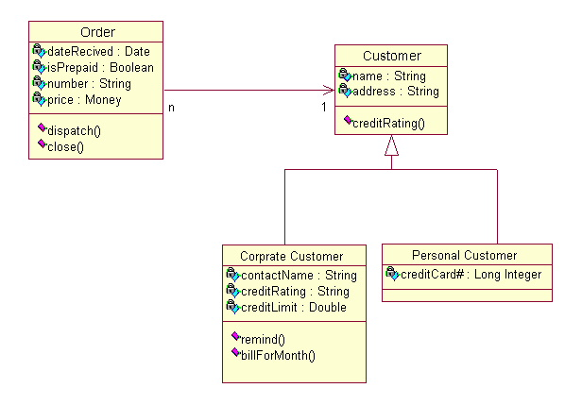
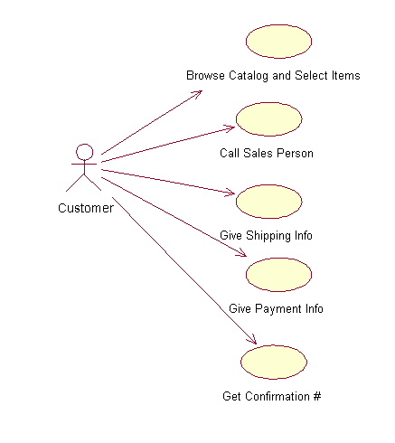
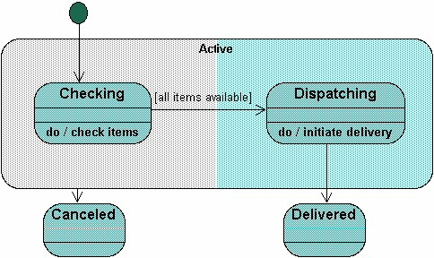
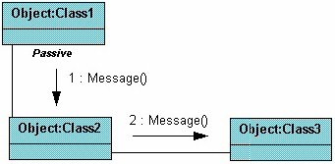
Current Design Representations
UML Diagrams
  Class
  Use Case
  Collaboration
  Sequence
  State chart
  Component
  Activity
* http://atlas.kennesaw.edu/~dbraun/csis4650/A&D/UML_tutorial/index.htm

Slide 34
Software Design Practices and Design Methods
Major Problem with Teaching Software Design is Scale
Roles for Software Design Methods
  Establishing Common Goals and Styles
  Generating “Consistent” Documentation
    Assist With Future Maintenance
    Recapture the Original Design Model
  Helping Make Some Features of a Problem More Explicit
Constraints That Limit Their Usefulness
  The Process Part of a Method Provides Relatively Little Detailed Guidance as to How a Problem Should be Solved
  The Need to Use a Procedural Form Leads to Practices That Conflict with the Behavior Observed in Experienced Designers

Slide 35
Design Strategies
Top-down
  Separate a Large Problem into Smaller Ones
Compositional
  Identifies a Set of “Entities” That Can be Modeled and Then Assembled to Create a Model for the Complete Solution
Organizational
  Use Where Development Organization and Management Structures Impose Constraints Upon the Design Process
Template
  Used Where Some General Paradigm Describes a Reasonably Large Domain of Problems

